Slide 1
14
BOHDAN GLISEVIC

Slide 2
DYNAMIC HYDROPHOBICITY
When a drop of liquid impacts on a horizontally moving surface, the droplet may be reflected or not, depending on the speed of the surface. Investigate the interaction between a moving surface and a liquid drop.

Slide 3
BASIC UNDERSTANDING

Slide 4
BASIC UNDERSTANDING
WETTABLITY
$$θ$$
$$θ$$
$$θ$$
hydrophilic
hydrophobic
superhydrophobic
Should we expect similar behaviour?
Maybe, but it will be rare…
Dependence on:
$$surface material$$
$$surface tension of the liquid$$
$$gas surrounding liquid and surface$$
$$θ>150°$$
$$θ−contact angle$$

Slide 5
BASIC EXPLANATION
SPEED OF THE SURFACE
$$θ is close to 90°$$
Change of the contact angle
will be velocity dependent
stationary surface
$$θ exceeds 90°$$
moving surface
Might be reflected or splashed

Slide 6
APPARATUS

Slide 7
APPARATUS
Suggestion
You can reuse the old setup from Problem No.13 of IYPT 2020 (Friction Oscillator)
pipette
Second Option:
belt
wheel
rollers
camera

Slide 8
THEORY

Slide 9
THEORETICAL MODEL
Parameters
$$η−dynamic viscosity$$
$$γ−surface tension$$
$$ρ−density$$
$$R$$
$$λ−shape factor$$
$$v_{s}$$
liquid nonsense
$$h$$
Let us make some key assumptions!

Slide 10
THEORETICAL MODEL
Stationary Surface
$$D_{max}$$

Slide 11
THEORETICAL MODEL
Moving Surface
$$D_{max}$$

Slide 12
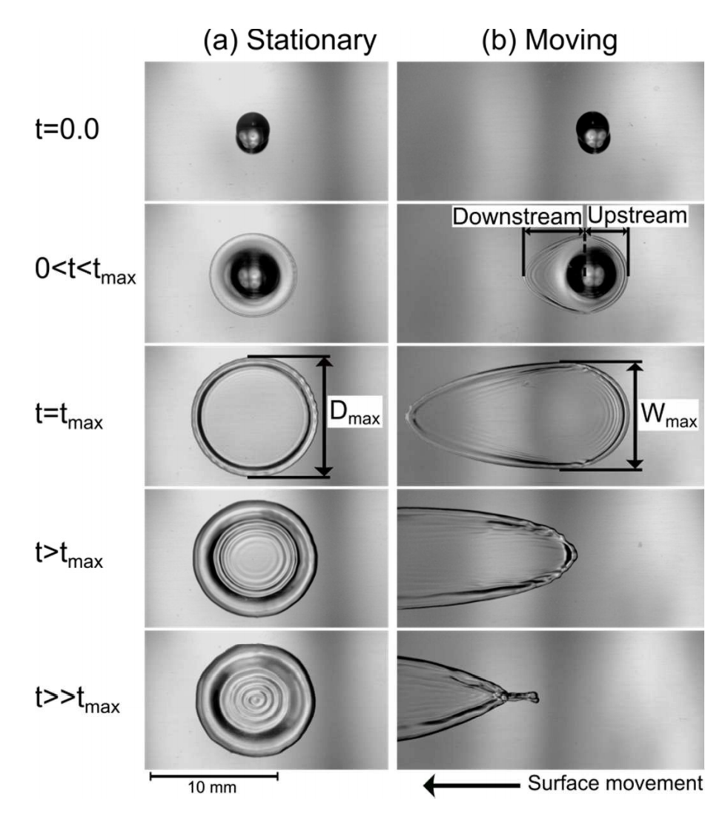
THEORETICAL MODEL
Radius
$$r\left(t\right)=R{\left[1−exp\left(−\left(\frac{2γ_{LG}}{R^{12}}+\frac{ρg}{9R^{10}}\right)\frac{24λV^{4}t}{π^{2}η}\right)\right]}^{\frac{1}{6}}$$
upstream
downstream

Slide 13
EXPERIMENTS

Slide 14
EXPERIMENTS
[1]
H.Almohammadi, A.Amirifazli, ‘Understanign the drop impact onto a moving hzdrophilic and hydrophobic surfaces’, Department of Mechanical Engineering, York University, Toronto
Velocity of the Surface - $v_{S}$
$$0m/s<v_{S}<17m/s$$
in paper [1]
try to focus on the boundary velocities when creating phase diagrams
Velocity of the Drop - $v_{N}$
Change initial height of the drop (pipette) – free fall
$$v_{N}=\sqrt{2gh}$$
Wettability of the Surface
Use variety of different surfaces and determine wettability by measing contact angle
for stationary surface for particular liquid
Hydrophilic – Stainless Steel $θ≈40°$
Use impregnation spray
Hydrophobic – Teflon $θ≈110°$

Slide 15
EXPERIMENTS
Surface Tension - $γ$
Use detergent to change surface tension of the water
dynamic viscosity and density should not be affected significantly
Dynamic Viscosity - $η$
Use glycerol to effectively change dynamic viscosity of the water
in paper [1]

Slide 16
EXPERIMENTS
Statistical Phase Diagrams
reflected
attached
splashed
$$Drop Velocity−v_{N}$$
$$Surface Velocity−v_{S}$$
always provide analysis of the statistical phase diagram

Slide 17
EXPECTATIONS

Slide 18
EXPECTATIONS
1
BEGINNERS
Change all parameters in the section EXPERIMENTS systematically
Velocity of the surface
Velocity of the droplet (height of the pipette)
Surface tension
Dynamic viscosity
Material of the surface (wettability)
Size of the droplet
Quantify wettability (by measing contact angle $θ$)
Create statistical phase diagrams
Provide qualitative explanation behind behaviour of the droplet (Why?)
Ability to control size of the droplets (good pipette)
Uncertainties in the measurement (essential for this problem)
one experiment is certainly not sufficient for overall understanding
Always provide proofs of your ideas of explanation (HFR video)

Slide 19
EXPECTATIONS
2
ADVANCED
Provide quantitative analysis of the experiment
Look at the behaviour of the droplets – change of lamella shape
Length of the upstream and downstream of the droplet for various velocities
Quantitative model describing change of contact angle
Phase diagrams with change of the droplets maximum diameter $D_{max}$ and analysis of critical diameter
Try to combine parameters of the liquid into one crucial parameter (try dimensionless numbers in hydro physics – Weber’s Number, Bond Number, Reynolds number, but justify their applicability
Provide quantitative theory and give predictions based on initial parameters

Slide 20
THANK YOU

